Slide 1
Bones of the Pelvic Girdle
And Lower Extremity

Slide 2
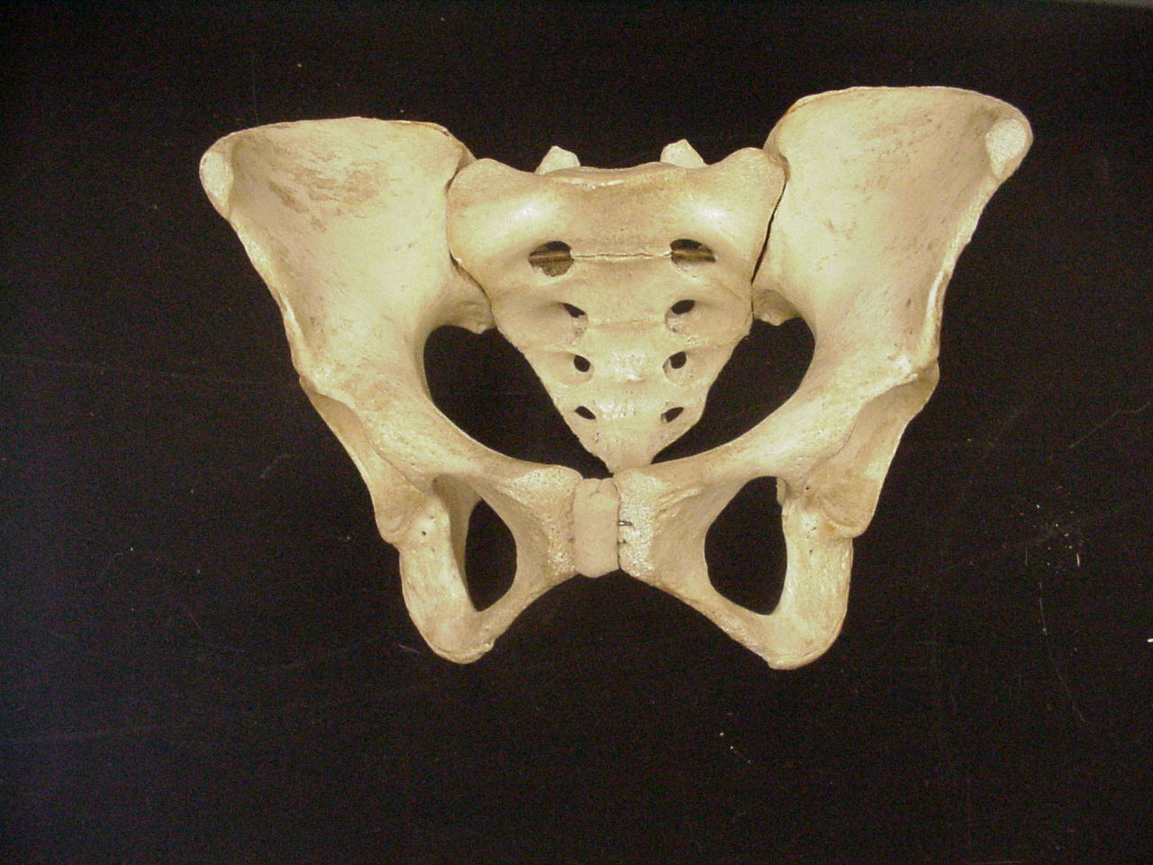
Sacrum
Ilium
Iliac Fossa
Pelvic Brim
Acetabulum
Obturator Foraman
Ischium
Pubis
Pubic Symphasis
Pelvis

Slide 3
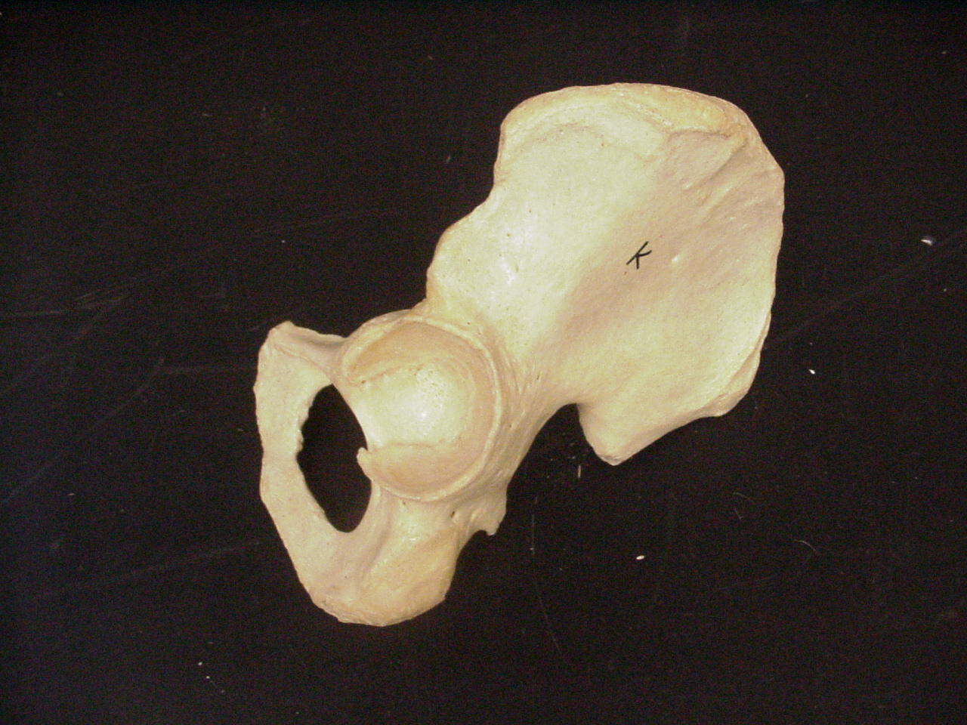
Iliac Crest
Coxal Bone
Posterior Superior Iliac Spine
Anterior Superior Iliac Spine
Anterior Inferior Iliac Spine
Posterior Inferior Iliac Spine
Acetabulum
Greater Sciatic Notch
Obturator Foramen
Ischial Tuberosity
Ischial Spine

Slide 4
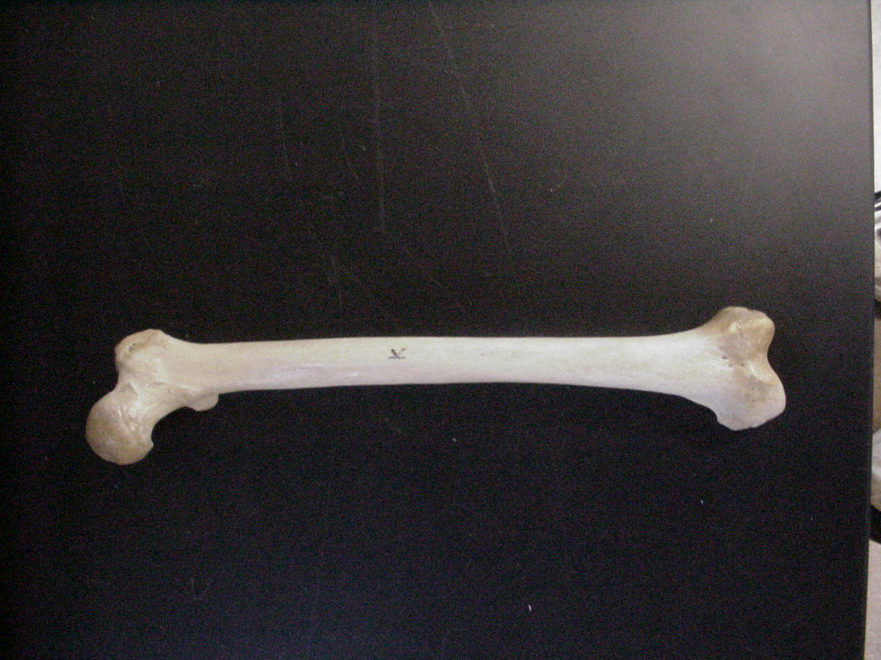
Greater Trochanter
Lateral Epicondyle
Inter- trochnteric Line
Medial Epicondyle
Lesser Trochanter
Head
Adductor Tubercle
Neck
Femur - Anterior

Slide 5
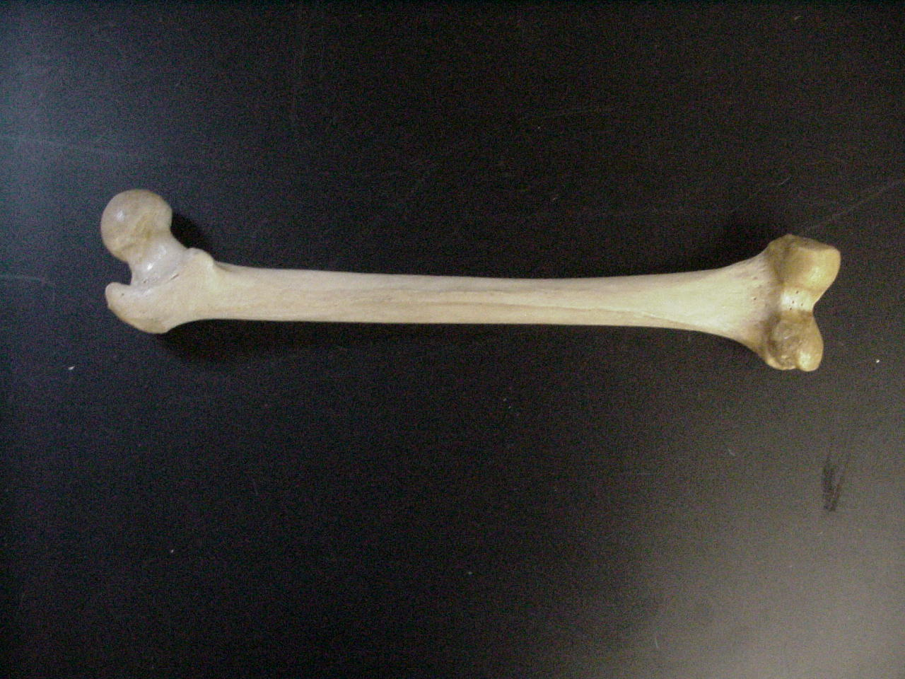
Femur - Posterior
Lesser Trochanter
Gluteal Tuberosity
Linea Aspera
Medial Epicondyle
Medial Condyle
Head
Lateral Condyle
Greater Trochanter
Inter- trochanteric Crest
Lateral Epicondyle

Slide 6
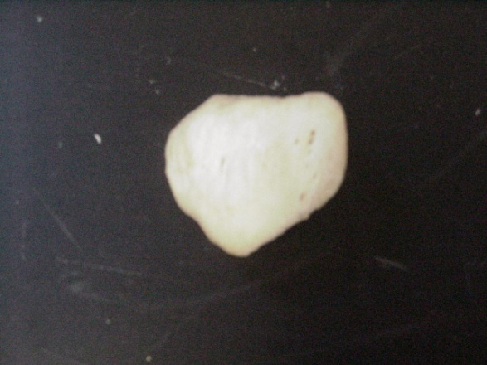
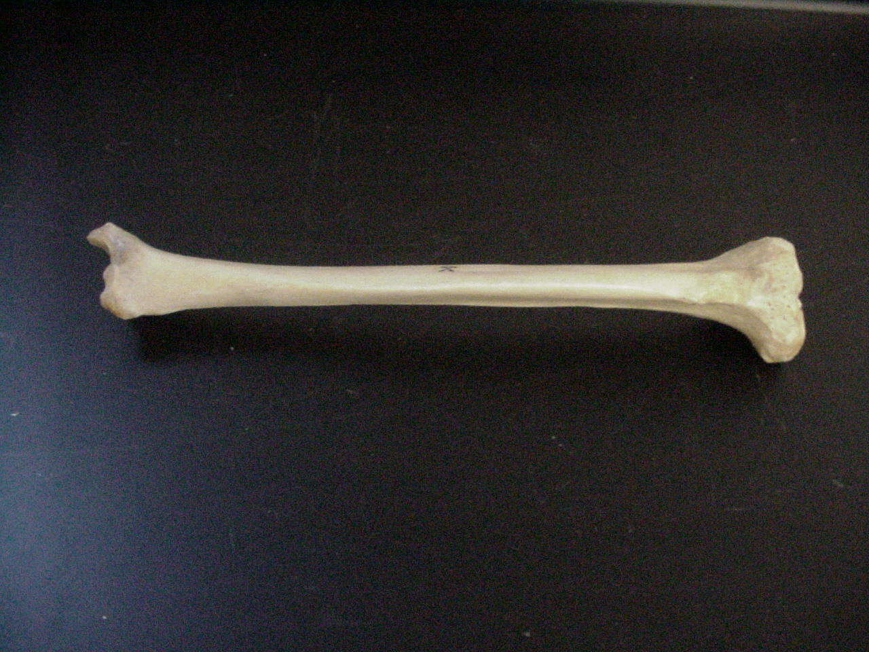
Patella & Tibia
Patella
Medial Malleolus
Anterior Tibial Crest
Tibial Tuberosity
Medial Condyle
Intercondylar Eminence
Lateral Condyle

Slide 7
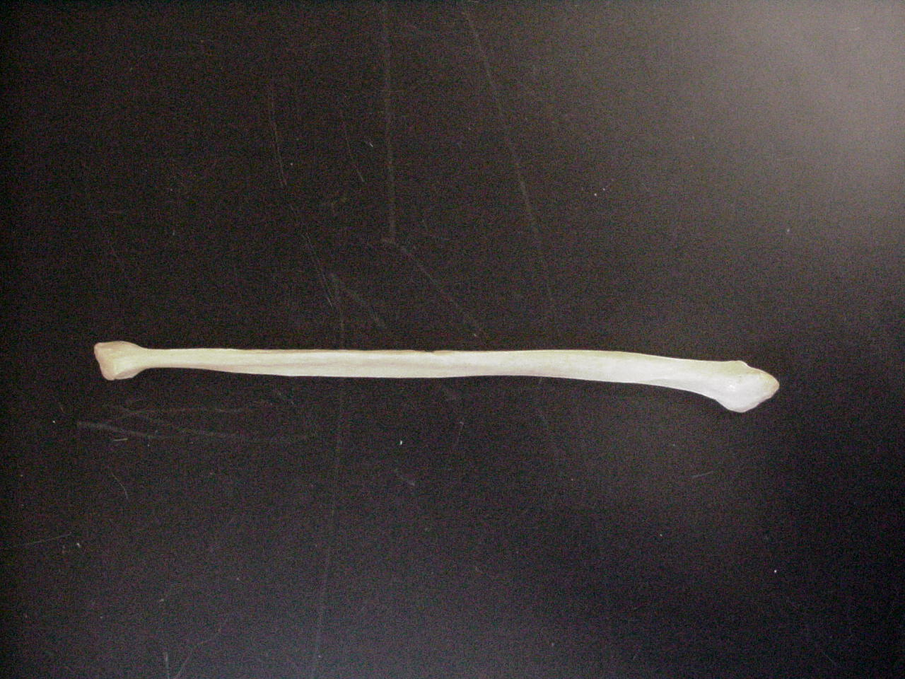
Fibula
Lateral Malleolus
Head

Slide 8
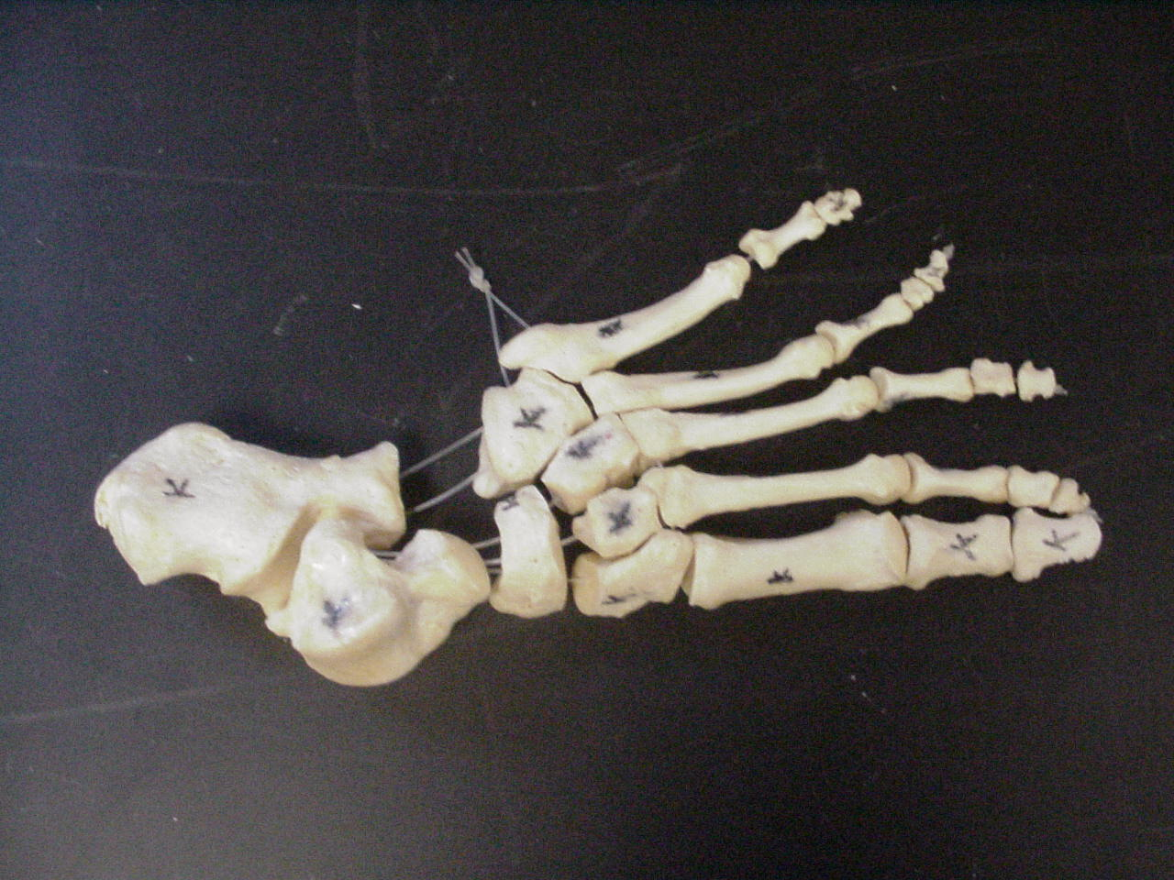
Proximal Phalanx
Middle Phalanx
5
4
Distal Phalanx
3
2
1
Proximal Phalanx
Tarsals
Metatarsals
Phalanges
Foot

Slide 9
Cuboid
Calcaneous
Talus
1st Cuneiform
Navicular
3rd Cuneiform
2nd Cuneiform
Foot - Tarsals

